Slide 1


Basic Details of the Team and Problem Statement
Government of Jharkhand
PS Code: 1500
Problem Statement Title:Education ecosystem for specially abled student need provision and improvement to take care of compliance, governance and conduct.
Team Name: Project Dron
Team Leader Name: A R Pranav Sathya
Institute Code (AISHE): C-16576
Institute Name: Chennai Institute of Technology
Theme Name: Smart Education

Slide 2
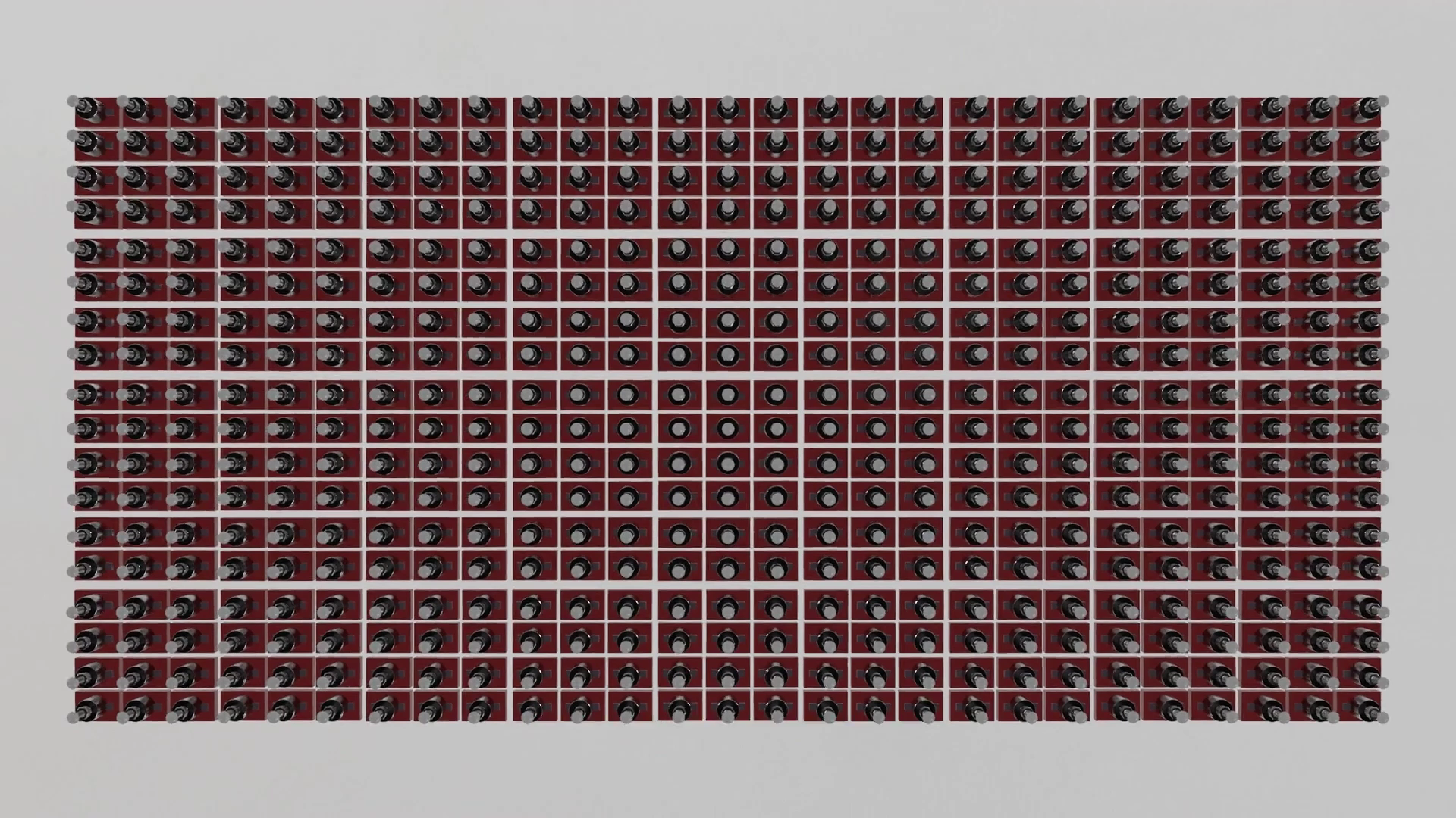

Approach Details
The aim and plan of tackling the issue
In cases of visual impairment in people, learning becomes a pretty challenging task.
It is were this device comes in handy to provide dynamic braille script.
This is achieved with the help of motors to display braille characters.
And multiplexers are used to increase the number of motors that can be used and operated by a single controller
Python
Raspberry Pi SBC
Motors
Multiplexers
Technology Stack:
Describe your Technology stack here:
2

Slide 3

Basic Details
Dependencies
Use Cases
Text to braille conversion
Power source
Understanding braille characters
Educational purposes
Converting textual data to braille
Eradicating need to waste braille material
Better experience reading braille text
Show Stopper
Physical challenges
Not knowing braille characters
Data verification
3

Slide 4
Team Member Details
Team Leader : A R Pranav Sathya
Branch : BE Stream : CSE Year : II
Team Member 1 : Abhishek Renjan U B
Branch : BE Stream : CSE Year : II
Team Member 2 : G K Yuvaraaj
Branch : BE Stream : CSE Year : II
Team Member 3 Name : Dharshini G A
Branch : BE Stream : CSE Year : II
Team Member 4 Name : S Aakash
Branch : BE Stream : CSE Year : II
Team Member 5 Name : Akash A
Branch : BE Stream : CSE Year : II
Team Mentor 1 Name: K.P.Aswathi
Category : Academic): Expertise : VLSI Domain Experience (in years) : 7 Years
Team Mentor 2 Name: T.Varadharajan
Category : Industry Expertise : Defense Domain Experience (in years): 7 years `

